Slide 1

PHARMACY MANAGEMENT SYSTEM

Slide 2

“Pharma_Hub”
"Welcome to Pharma_Hub”, A computerized system to help pharmacies manage their operations. A pharmacy management system is a specialized form of software designed to handle the various operations within a pharmacy It makes tasks like adding new users, updating medicines, and selling easier. Makes managing a pharmacy more efficient. Helps keep track of medicines and sales accurately. The Pharmacy Management System simplifies tasks and improves efficiency in pharmacies. It's an essential tool for modern pharmacies to manage their operations effectively.

Slide 3
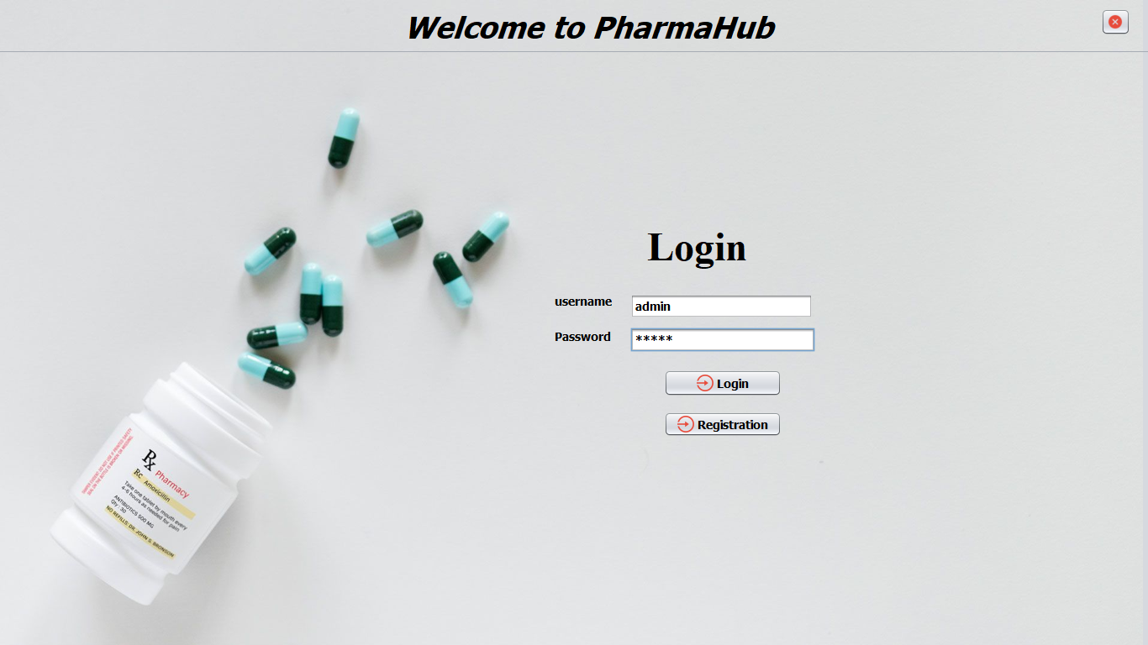
Login Page

Slide 4
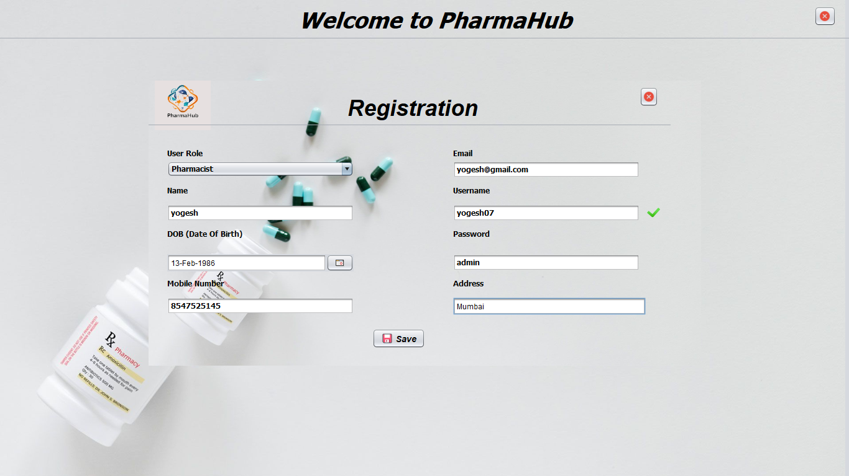
Registration Page

Slide 5

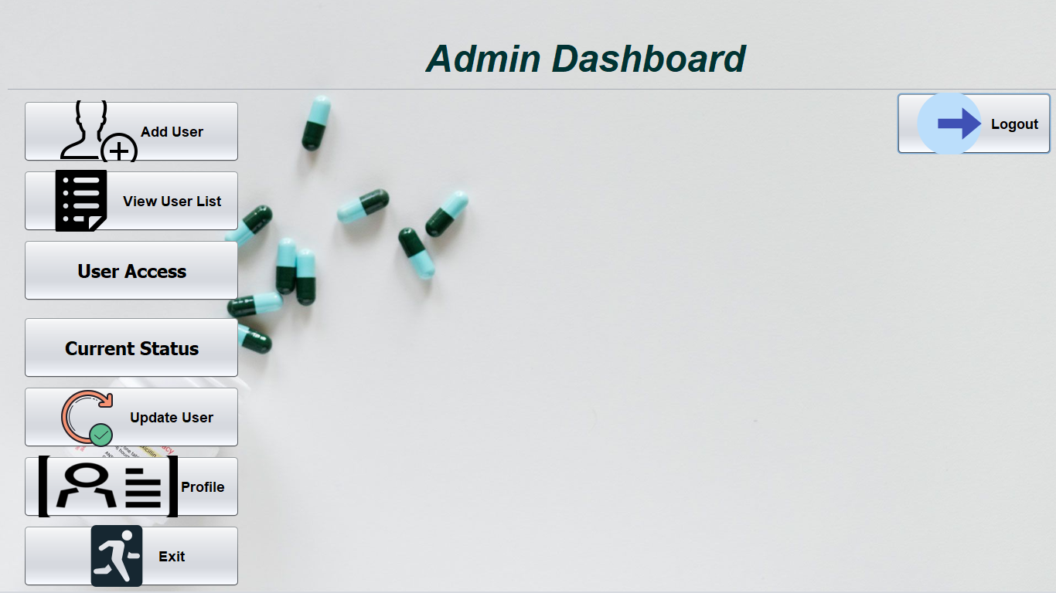

Slide 6
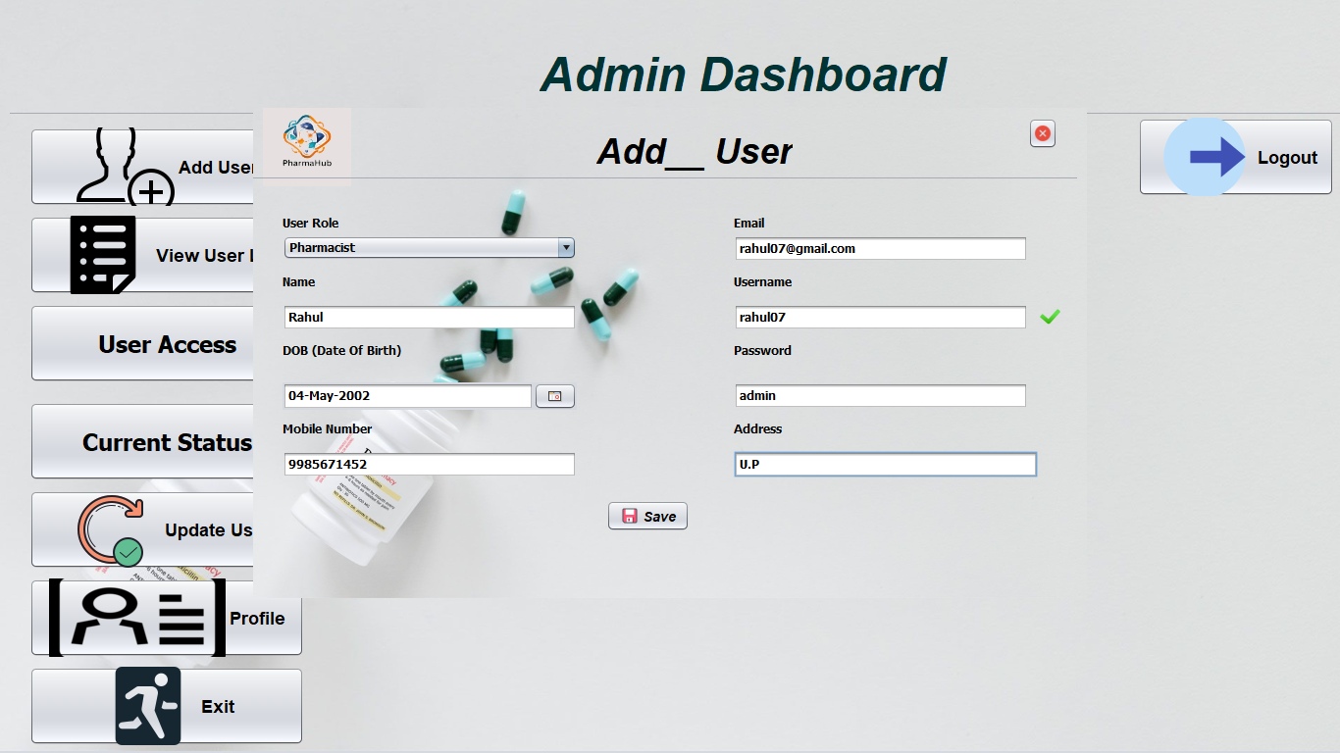

Slide 7
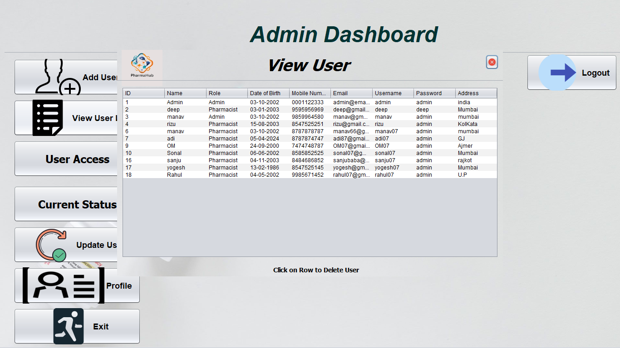

Slide 8
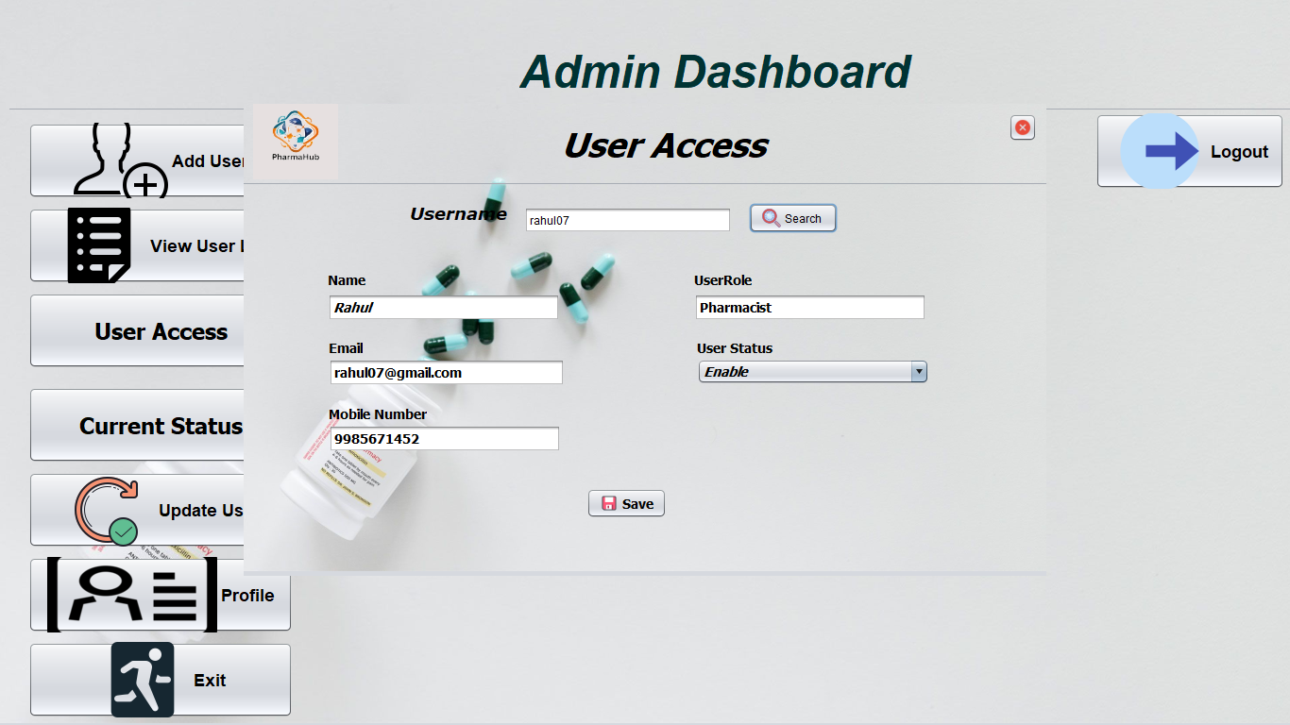

Slide 9

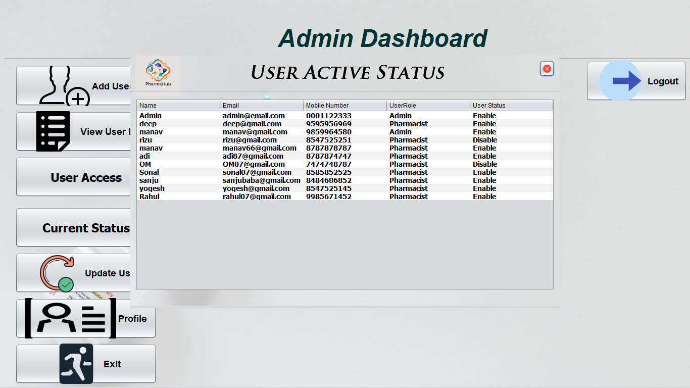

Slide 10
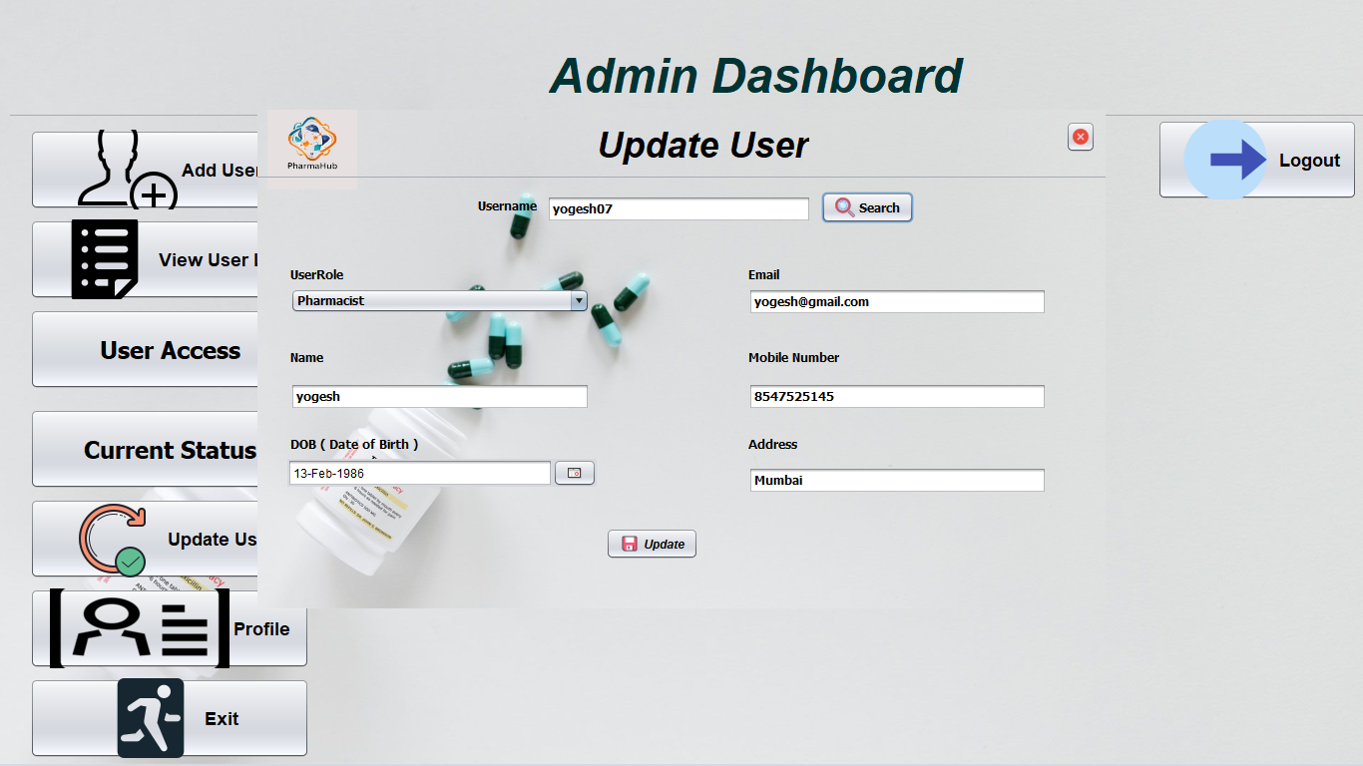

Slide 11

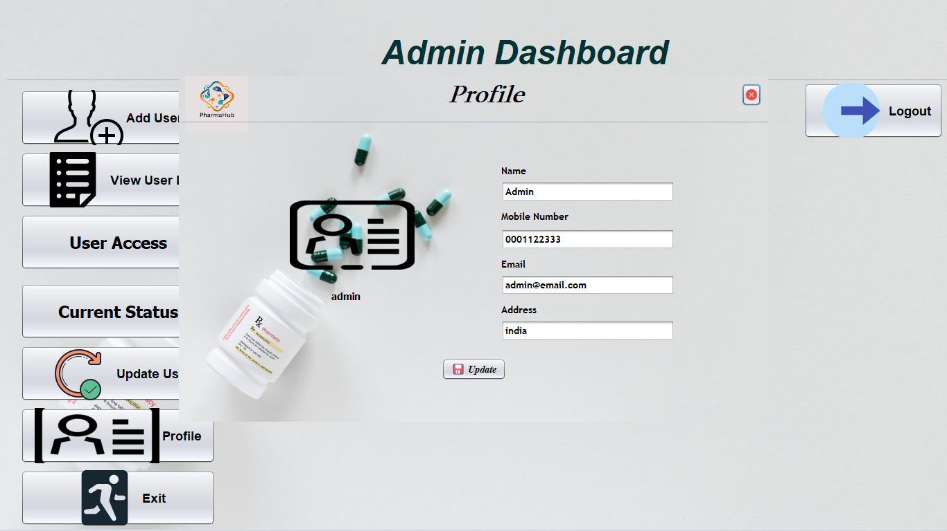

Slide 12
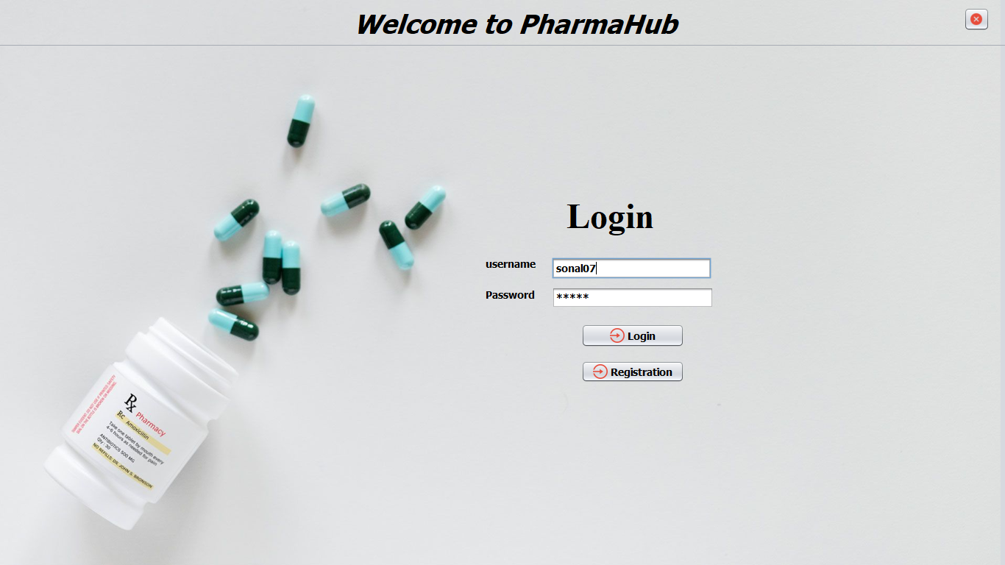
Pharmacist Login

Slide 13
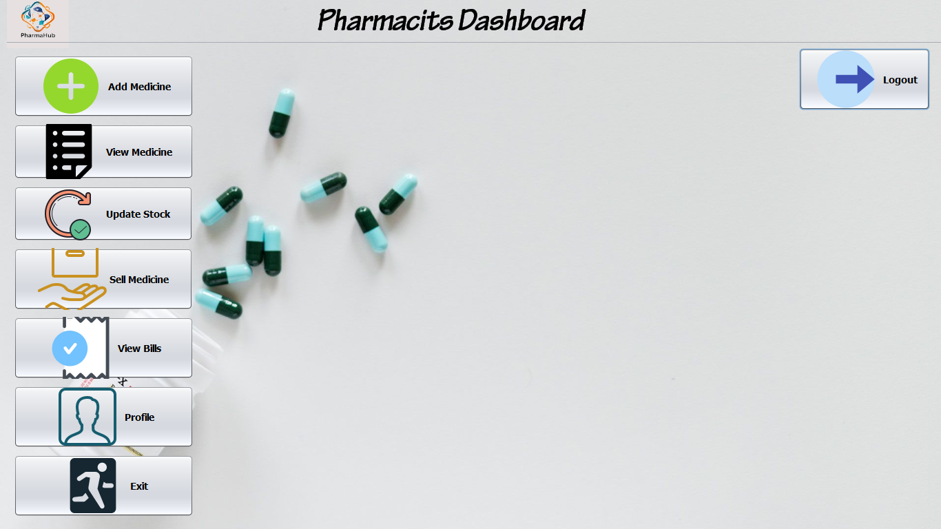

Slide 14
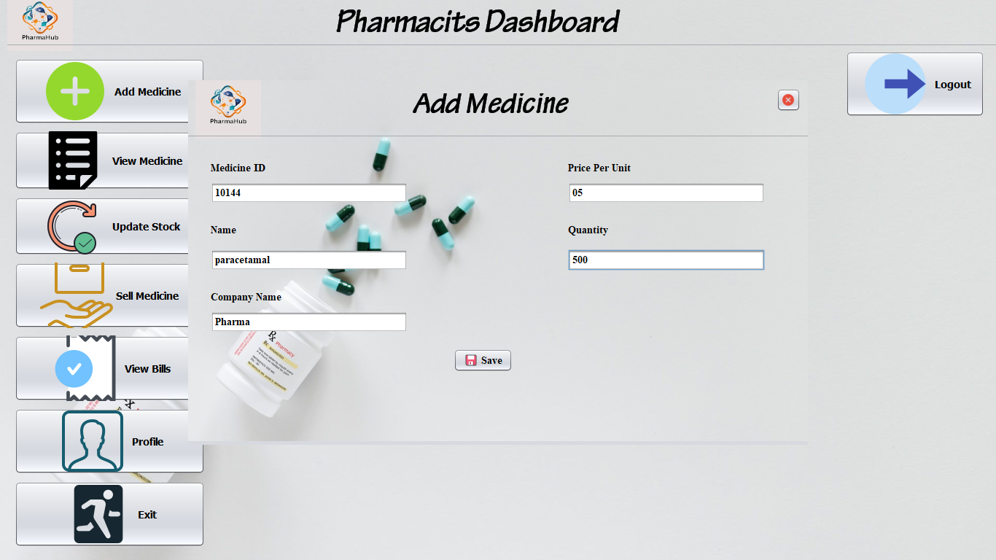

Slide 15

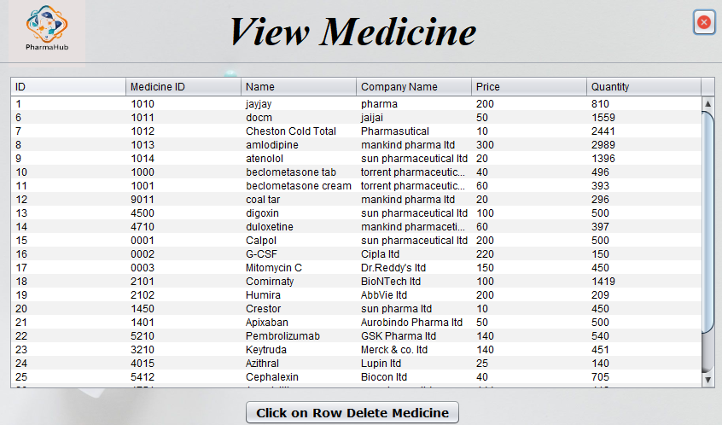

Slide 16
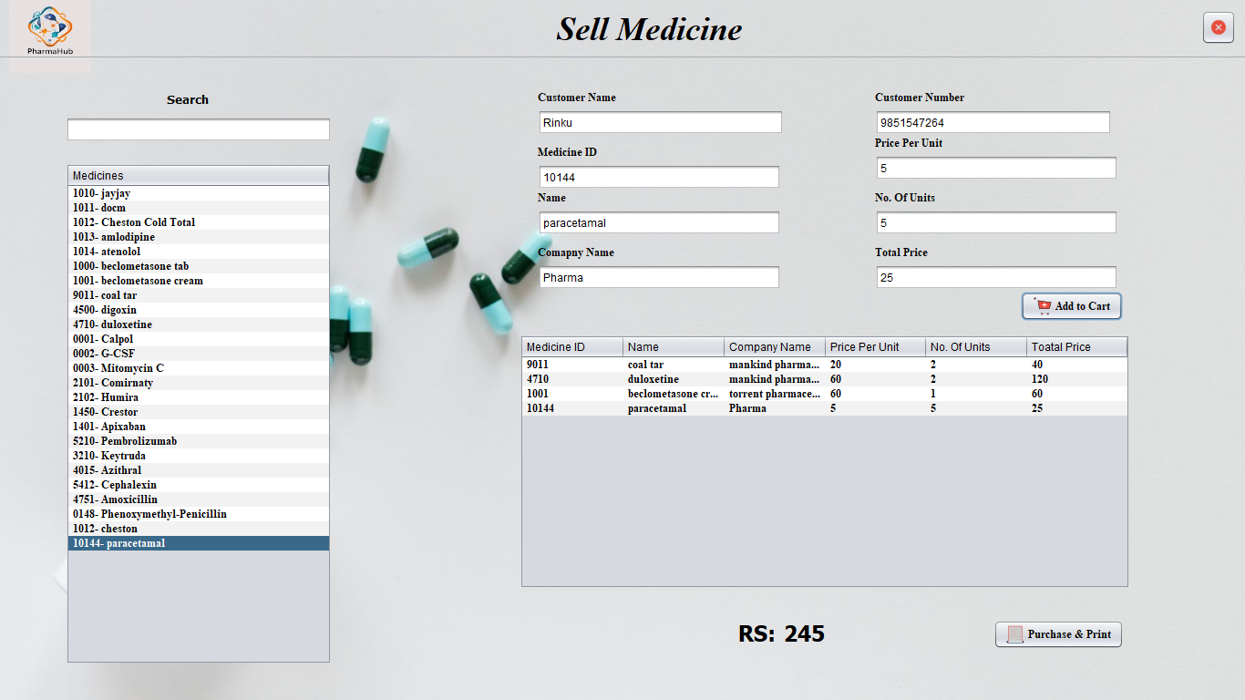

Slide 17
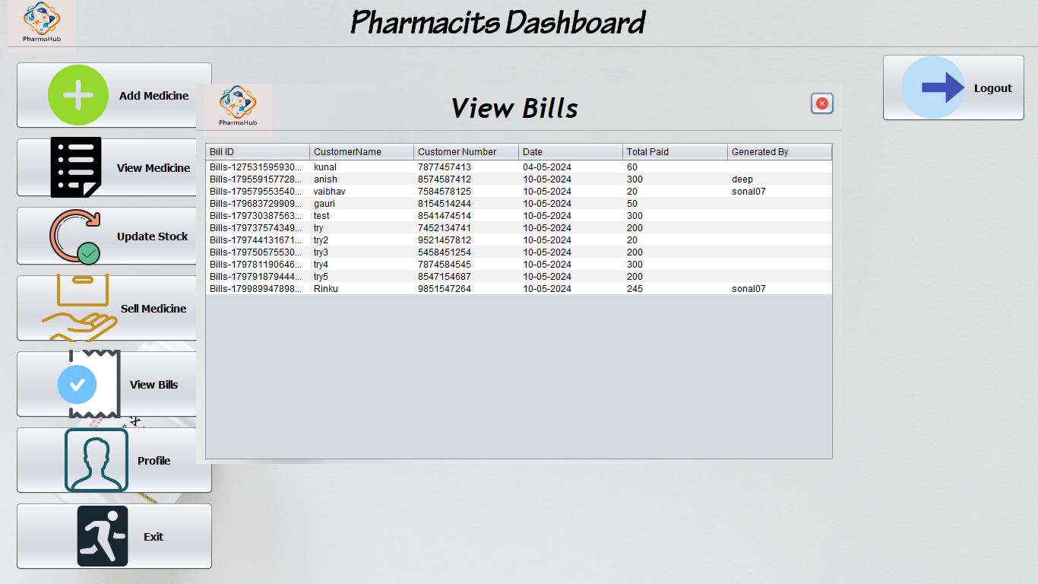

Slide 18
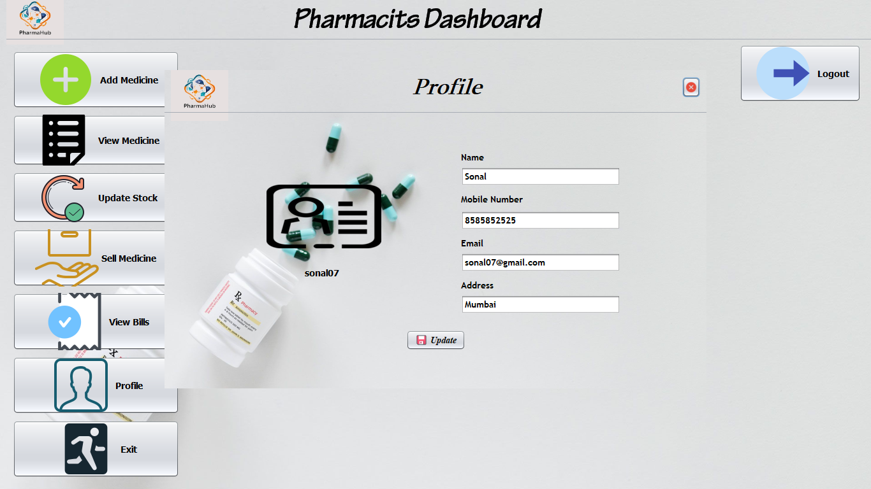

Slide 19


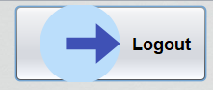
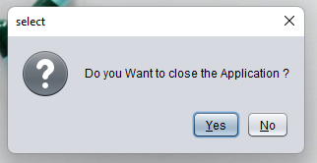
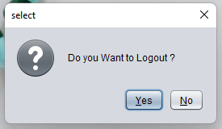

Slide 20
Thank You
Pharmacy Management System

